Slide 1
WELCOME TO
NAAC PEER TEAM
Department of Chemistry
Andhra University
Visakhapatnam

Slide 2
VISION
To be the source of knowledge and training in chemistry, to give a strong foundation in chemistry which generates original and innovative research in contemporary chemical themes.
MISSION
To provide quality education in chemistry at masters and doctoral levels
To establish research collaborations with good institutes/laboratories
To carry out sponsored R&D projects from national/government/private institutes.

Slide 3
QUALITY POLICY
To strive for excellence, in all Academic and co-curricular activities to provide stakeholder value, by creating competent and empowered students who are socially productive and morally upright.

Slide 5
Programmes Offered
M.Sc Chemistry with Analytical Chemistry as specialization
M.Sc Chemistry with Inorganic Chemistry as specialization
M.Sc Chemistry with Physical Chemistry as specialization
Ph.D Chemistry
M.Sc Chemistry with Organic Chemistry as specialization
M.Sc Chemistry with Analysis of Foods and Drugs as specialization

Slide 6
Recognition of the department by funding agencies
DST-FIST
UGC-SAP-DRS

Slide 7
Students profile in the last five years
Degree-wise (M.Sc., and Ph.D.) actual number of passing out students in the last five years
Number of Students (year-wise) qualified in NET/INSPIRE/GATE
About 100% of passed out students get placements in industries (Aurobindo, GVK bio, Dr. Reddys, Mylan, Aragen, Hetero drugs. etc) and colleges(Bhashyam, Sri chaitanya, Narayana…)
No. of Students passed in each degree | 2018 | 2019 | 2020 | 2021 | 2022 | Total
M.Sc. | 103 | 108 | 115 | 114 | 122 | 562
Ph.D. | 18 | 33 | 08 | 13 | 12 | 84
NET/GATE/ INSPIRE (~10% of MSc) | 10 | 11 | 07 | 12 | 11 | 52

Slide 8
Demand Ratio Program Name: M.Sc. Chemistry Program Code : 104
Year | Seats available/sanctioned | Applications Received | Demand Ratio/ Year | Average of last 5 yrs
2017-18 2018-19 2019-20 2020-21 | 114 114 121 121 | 4872 4529 4834 4926 | 45.53 37.43 39.62 40.71 | 40.82
Student Strength
Year wise | 2017-18 | 2018-19 | 2019-20 | 2020-21 | 2021-22
No of students admitted | 117 | 126 | 123 | 123 | 120

Slide 9
Inputs from stakeholders/
Constituents
Define PO’s & CO’s using Bloom’s taxonomy
Vision/Mission
Map courses- CO with PO
OUTCOME BASED
EDUCATION
Identify gaps
Suitable measures
Remedial actions
Course planning & delivery
Prepare lecture notes
Define pedagogical tool
Define rubrics for tutorials, Practical's ,Seminars, Projects and assignments
NO
YES
Strongly mapped
If target value ≥ 2.6
Measurement of PO attainment
Measurement of CO attainment

Slide 10
Teaching – Learning process through Power Point Presentation
Methods of teaching
Tutorial write-up for slow learners
Mentor – Mentee system implemented
Guest lectures/Industrial visits
Academic Calendar strictly followed

Slide 11
PROGRAM OUTCOMES (PO):
Mould a generation of youth to apply the subject knowledge in their life and careers
Inculcate scientific attitude enriched with a multidisciplinary perspective in the students.
Demonstrate broad knowledge of descriptive Chemistry.
Impart basic analytical & technical skills to work effectively in various fields of chemistry.
Motivate critical thinking & analytical skills to solve complex chemical problems, e.g., analysis of data, synthetic logic, spectroscopy, structure and modeling, team-based problem solving, etc.
Demonstrate ability to conduct experiments in the above sub-disciplines with mastery of appropriate techniques and proficiency using core chemical instrumentation & modeling methods.
Demonstrate ability to perform accurate quantitative measurements with understanding of theory & use of contemporary chemical instrumentation, interpret experimental results, perform calculations on these results and draw reasonable, accurate conclusions.
Demonstrate ability to synthesize, separate & characterize compounds using published reactions, protocols, standard laboratory equipment, and modern instrumentation.

Slide 12
INORGANIC CHEMISTRY SPECIALIZATION
I SEMESTER |  |  | II SEMESTER
Course code | Course Title |  | Course code | Course Title
SCS-117 | General Chemistry-I |  | SCS-215 | General Chemistry-II
SCS-118 | Inorganic Chemistry-I |  | SCS-216 | Inorganic Chemistry-II
SCS-119 | Organic Chemistry-I |  | SCS-217 | Organic Chemistry-II
SCS-120 | Physical Chemistry-I |  | SCS-218 | Physical Chemistry-II
PR-347 | Inorganic Chemistry Laboratory-1
 |  |  | PR-350 | Inorganic Chemistry Laboratory-1I
PR-348 | Physical Chemistry Laboratory-1 |  | PR-351 | Physical Chemistry Laboratory-I1
PR-349 | Organic Chemistry Laboratory-1 |  | PR-352 | Organic Chemistry Laboratory-1I
III SEMESTER |  |  | IV SEMESTER
Course Code | Course Title |  | Course Code |  | Course Title
SCIS-307 | Paper-I: Solid State Chemistry -1 |  | SCIS-411 |  | Paper-I: Solid State Chemistry -II
SCIS308 | Paper-II: Structure, Bonding and Reactivity of coordination compounds– I |  | SCIS-407 |  | Paper-II: Structure, Bonding and Reactivity of coordination compounds–II
SCIS-309 | Paper-III: Bio-inorganic Chemistry |  | SCIS408 |  | Paper-III: Organometallic Chemistry
SCIS-312 | Paper-IV: Physical Methods In Inorganic Chemistry-I |  | SCIS-414 |  | Paper-IV: Physical Methods In Inorganic Chemistry-II
PR-725 | Practical - I: Classical Methods of Analysis |  | PR-A1328 |  | Project Work
PR-725 | Practical - II: Instrumental Methods of Analysis |  | PR-726 |  | Practical - I: Classical Methods of Analysis
PR-A1328 | MOOCs Course |  | PR-726 |  | Practical - II: Instrumental Methods of Analysis

Slide 13
ORGANIC CHEMISTRY SPECIALIZATION
I SEMESTER |  |  | II SEMESTER
Course code | Course Title |  | Course code | Course Title
SCS-117 | General Chemistry-I |  | SCS-215 | General Chemistry-II
SCS-118 | Inorganic Chemistry-I |  | SCS-216 | Inorganic Chemistry-II
 |  |  | SCS-217 | Organic Chemistry-II
SCS-119 | Organic Chemistry-I
SCS-120 | Physical Chemistry-I |  | SCS-218 | Physical Chemistry-II
PR-347 | Inorganic Chemistry Laboratory-1
 |  |  | PR-350 | Inorganic Chemistry Laboratory-1I
PR-348 | Physical Chemistry Laboratory-1 |  | PR-351 | Physical Chemistry Laboratory-I1
PR-349 | Organic Chemistry Laboratory-1 |  | PR-352 | Organic Chemistry Laboratory-1I
III SEMESTER |  |  | IV SEMESTER
Course Code | Course Title |  | Course Code |  | Course Title
SCOS-315 | Paper-I: Organic Reaction Mechanisms, Pericyclic Reactions and Photochemistry |  | SCOS-416 |  | Paper-I: Modern Synthetic Methodology in Organic Chemistry
SCOS-316 | Paper-II: Organic Spectroscopy |  | SCOS-417 |  | Paper-II: Organic Spectroscopy and Structure determination of Natural Products
SCOS-317 | Paper-III: Organic Synthesis |  | SCOS-418 |  | Paper-III: Designing Organic Synthesis and Synthetic Applications of Organo-Boranes and silanes
SCOS-318 | Paper-IV: Chemistry of Natural Products |  | SCOS-419 |  | Paper-IV: Drug Design and Drug Chemistry
PR-819 | Practical - I: Multi Stage Organic Synthesis |  | PW-A83 |  | Project Work
PR-A1060 | Practical - II: Chromatography & Viva-Voce |  | PR-820 |  | Practical - I: Organic Mixture Analysis
PR-A1328 | MOOCs Course |  | PR-A1050 |  | Practical - II: Estimations and Isolation

Slide 14
PHYSICAL CHEMISTRY SPECIALIZATION
I SEMESTER |  |  |  | II SEMESTER
Course code | Course Title |  |  | Course code | Course Title
SCS-117 | General Chemistry-I |  |  | SCS-215 | General Chemistry-II
SCS-118 | Inorganic Chemistry-I |  |  | SCS-216 | Inorganic Chemistry-II
SCS-119 | Organic Chemistry-I |  |  | SCS-217 | Organic Chemistry-II
SCS-120 | Physical Chemistry-I |  |  | SCS-218 | Physical Chemistry-II
PR-347 | Inorganic Chemistry Laboratory-1
 |  |  |  | PR-350 | Inorganic Chemistry Laboratory-1I
PR-348 | Physical Chemistry Laboratory-1 |  |  | PR-351 | Physical Chemistry Laboratory-I1
PR-349 | Organic Chemistry Laboratory-1 |  |  | PR-352 | Organic Chemistry Laboratory-1I
III SEMESTER |  |  |  | IV SEMESTER
Course Code |  | Course Title |  | Course Code |  | Course Title
SCPS-317 |  | Paper-I: Polymer Chemistry and Photochemistry |  | SCPS-415 |  | Paper-I: Advanced Chemical Kinetics and Physical-Organic Chemistry
SCPS-318 |  | Paper-II: Quantum Chemistry-II and Chemical Applications of Symmetry and Group Theory |  | SCPS-416 |  | Paper-II: Quantum Chemistry-III, Numerical Methods for Chemists and Advanced Computer Programming
SCPS-319 |  | Paper-III: Statistical Thermodynamics and Solution Equilibria of Metal Complexes |  | SCPS-417 |  | Paper-III: Advanced Thermodynamics and Biophysical Chemistry
 |  |  |  | SCPS-418 |  | Paper-IV: Spectroscopy
SCPS-320 |  | Paper-IV: Instrumentation
PR-A1506 |  | Practical - I: Classical Methods of Analysis |  | PW-A83 |  | Project Work
PR-A1507 |  | Practical - II: Instrumental Methods of Analysis |  | PR-868 |  | Practical - I: Classical Methods of Analysis
PR-A1328 |  | MOOCs Course |  | PR-868 |  | Practical - II: Instrumental Methods of Analysis
 |  |  |  | VV-678 |  | Viva-Voce
 |  |  |  | PR-A1328 |  | MOOCs Course

Slide 15
ANALYTICAL CHEMISTRY SPECIALIZATION
I SEMESTER |  |  | II SEMESTER
Course code | Course Title |  | Course code | Course Title
SCS-117 | General Chemistry-I |  | SCS-215 | General Chemistry-II
SCS-118 | Inorganic Chemistry-I |  | SCS-216 | Inorganic Chemistry-II
SCS-119 | Organic Chemistry-I |  | SCS-217 | Organic Chemistry-II
SCS-120 | Physical Chemistry-I |  | SCS-218 | Physical Chemistry-II
PR-347 | Inorganic Chemistry Laboratory-1
 |  |  | PR-350 | Inorganic Chemistry Laboratory-1I
PR-348 | Physical Chemistry Laboratory-1 |  | PR-351 | Physical Chemistry Laboratory-I1
PR-349 | Organic Chemistry Laboratory-1 |  | PR-352 | Organic Chemistry Laboratory-1I
III SEMESTER |  |  | IV SEMESTER
Course Code | Course Title |  | Course Code |  | Course Title
SCAS313 | Paper-I: Separation Methods-I |  | SCAS-412 |  | Paper-I: Separation Methods-II
SCAS309 | Paper-II: Quality Control and Traditional Methods of Analysis-I |  | SCAS-408 |  | Paper-II: Quality Control and Traditional Methods of Analysis-II
SCAS310 | Paper-III: Applied Analysis-I |  | SCAS-409 |  | Paper-III: Applied Analysis-II
SCAS311 | Paper-IV: Instrumental Methods of Analysis-I |  | SCAS-413 |  | Paper-IV: Instrumental Methods of Analysis-II
PR-353 | Practical - I: Classical Methods of Analysis |  | PW-A83 |  | Project Work
PR-353 | Practical - II: Instrumental Methods of Analysis |  | PR-354 |  | Practical - I: Classical Methods of Analysis
PR-A1328 | MOOCs Course |  | PR-354 |  | Practical - II: Instrumental Methods of Analysis
 |  |  | VV-701 |  | Comprehensive Viva-Voce
 |  |  | PR-A1328 |  | MOOCs Course

Slide 16
CHEMISTRY ANALYSIS OF FOODS, DRUGS & WATER SPECIALIZATION
I SEMESTER |  |  | II SEMESTER
Course code | Course Title |  | Course code | Course Title
SCS-117 | General Chemistry-I |  | SCS-215 | General Chemistry-II
SCS-118 | Inorganic Chemistry-I |  | SCS-216 | Inorganic Chemistry-II
SCS-119 | Organic Chemistry-I |  | SCS-217 | Organic Chemistry-II
SCS-120 | Physical Chemistry-I |  | SCS-218 | Physical Chemistry-II
PR-347 | Inorganic Chemistry Laboratory-1
 |  |  | PR-350 | Inorganic Chemistry Laboratory-1I
PR-348 | Physical Chemistry Laboratory-1 |  | PR-351 | Physical Chemistry Laboratory-I1
PR-349 | Organic Chemistry Laboratory-1 |  | PR-352 | Organic Chemistry Laboratory-1I
III SEMESTER |  |  | IV SEMESTER
Course Code | Course Title |  | Course Code |  | Course Title
SCWS310 | Chemistry of Drugs-I |  | SCWS411 |  | Chemistry of Foods-I
SCWS311 | Chemistry of Drugs-II |  | SCWS412 |  | Chemistry of Foods-II
SCWS312 | Drug Analysis-I |  | SCWS413 |  | Food Analysis-I
SCWS313 | Drug Analysis-II |  | SCWS414 |  | Food Analysis-II
PR-733 | Practical-I:Drug analysis-I |  | PW-A83 |  | Project work
PR-A1062 | Practical-II: Drug analysis-II |  | PR-734 |  | Practical-I:FoodAnalysis
PR-A1328 | MOOC course |  | PR-A1062 |  | Practical-II: WaterAnalysis
 |  |  | VV-647 |  | Comprehensive Viva-Voce
 |  |  | PR-A1328 |  | MOOC course

Slide 17
Course name | PO1 | PO2 | PO3 | PO4 | PO5 | PO6 | PO7 | PO8
 | PO Attainment Levels ( 0 to 3) (May be decimal)
General Chemistry-I | 2.80 | 2.80 | 3.00 | 3.00 | 2.60 | 2.20 | 3.00 | 0.00
Inorganic Chemistry-I | 3.00 | 3.00 | 3.00 | 2.20 | 2.60 | 2.00 | 2.50 | 0.00
Organic Chemistry-I | 3.00 | 2.60 | 2.60 | 2.80 | 2.20 | 3.00 | 2.40 | 2.60
Physical Chemistry-I | 3.00 | 3.00 | 3.00 | 3.00 | 3.00 | 3.00 | 3.00 | 3.00
Inorganic Chemistry Practical | 3.00 | 3.00 | 3.00 | 2.00 | 2.67 | 2.67 | 2.67 | 3.00
Organic Chemistry Practical | 3.00 | 2.60 | 2.60 | 2.80 | 2.20 | 3.00 | 2.40 | 2.60
Physical Chemistry Practical | 3.00 | 3.00 | 3.00 | 3.00 | 3.00 | 3.00 | 3.00 | 0.00
General Chemistry-II | 3.00 | 3.00 | 2.60 | 2.80 | 2.80 | 2.00 | 2.25 | 0.00
Inorganic Chemistry-II | 3.00 | 2.80 | 3.00 | 2.60 | 2.20 | 2.40 | 2.60 | 3.00
Organic Chemistry-II | 3.00 | 2.40 | 2.80 | 2.60 | 2.80 | 2.20 | 2.20 | 2.80
Physical Chemistry-II | 3.00 | 3.00 | 2.75 | 3.00 | 3.00 | 3.00 | 2.75 | 3.00
Inorganic Chemistry Practical | 2.75 | 2.75 | 2.50 | 3.00 | 2.25 | 3.00 | 2.75 | 3.00
Organic Chemistry Practical | 3.00 | 2.40 | 2.80 | 2.60 | 2.80 | 2.20 | 2.20 | 2.80
Physical Chemistry Practical | 3.00 | 3.00 | 3.00 | 3.00 | 3.00 | 3.00 | 3.00 | 3.00
Polymer Chemistry & Photochemistry | 3.00 | 3.00 | 3.00 | 3.00 | 3.00 | 3.00 | 3.00 | 3.00
Quantum Chemistry -II & Chemistry application of Group theory | 2.80 | 2.80 | 2.80 | 3.00 | 2.80 | 2.40 | 2.80 | 0.00
Statistical thermodynamics & Chemical equilibria of metal complexes | 3.00 | 3.00 | 0.00 | 3.00 | 0.00 | 0.00 | 0.00 | 0.00
Instrumentation | 3.00 | 3.00 | 0.00 | 3.00 | 3.00 | 3.00 | 3.00 | 0.00
Practical -I: Chemical Kinetics-I | 3.00 | 3.00 | 3.00 | 3.00 | 3.00 | 3.00 | 3.00 | 0.00
Practical -II: Instrumentation-I | 3.00 | 3.00 | 3.00 | 3.00 | 3.00 | 3.00 | 3.00 | 0.00
Advanced chemical kinetics & Physical Organic chemistry | 3.00 | 3.00 | 3.00 | 3.00 | 3.00 | 0.00 | 0.00 | 0.00
Quantum chemistry-III, Numerical methods for Chemists and Advanced computer programming | 3.00 | 3.00 | 3.00 | 3.00 | 3.00 | 0.00 | 0.00 | 0.00
Advanced Thermodynamics & Biophysical Organic chemistry | 3.00 | 3.00 | 3.00 | 3.00 | 0.00 | 0.00 | 3.00 | 0.00
Spectroscopy | 3.00 | 3.00 | 3.00 | 3.00 | 3.00 | 3.00 | 3.00 | 0.00
Chemical kinetics-II | 3.00 | 3.00 | 3.00 | 3.00 | 3.00 | 3.00 | 3.00 | 0.00
Instrumentation -II | 3.00 | 3.00 | 3.00 | 3.00 | 3.00 | 3.00 | 3.00 | 0.00
PO Attainment Level (Average PO Attainment of Physical Chemistry Program) | 2.98 | 2.89 | 2.89 | 2.86 | 2.79 | 2.73 | 2.76 | 2.89
CO-PO MAPPING AND PO ATTAINMENT
General Chemistry-I TH-SCS-117 |  | PO1 | PO2 | PO3 | PO4 | PO5 | PO6 | PO7 | PO8
 | CO1 | 3 | 3 | 3 | 3 | 3 | 2 | 3 | -
 | CO2 | 3 | 3 | 3 | 3 | 3 | 2 | 3 | -
 | CO3 | 3 | 3 | 3 | 3 | 3 | 2 | 3 | -
 | CO4 | 2 | 2 | 3 | - | 2 | 2 | - | -
 | CO5 | 3 | 3 | 3 | 3 | 2 | 3 | 3 | -
 | CO average | 2.8 | 2.8 | 3 | 3 | 2.6 | 2.2 | 3 | 0
Inorganic Chemistry-I TH-SCS-118 |  | PO1 | PO2 | PO3 | PO4 | PO5 | PO6 | PO7 | PO8
 | CO1 | 3 | 3 | 3 | 3 | 2 | - | 2 | -
 | CO2 | 3 | 3 | 3 | 2 | 2 | 2 | - | -
 | CO3 | 3 | 3 | 3 | 2 | 2 | 2 | - | -
 | CO4 | 3 | 3 | 3 | 2 | 2 | 2 | - | -
 | CO5 | 3 | 3 | 3 | 2 | 3 |  | 3 | -
 | CO average | 3 | 3 | 3 | 2.2 | 2.6 | 2 | 2.5 | -
Physical Chemistry-I TH-SCS-120 |  | PO1 | PO2 | PO3 | PO4 | PO5 | PO6 | PO7 | PO8
 | CO1 | 3 | 3 | 3 | - | - | 3 | - | 3
 | CO2 | 3 | 3 | 3 | - | - | 3 | - | 3
 | CO3 | 3 | 3 | 3 | - | - | 3 | - | 3
 | CO4 | 3 | 3 | 3 | 3 | 3 | 3 | 3 | 3
 | CO5 | 3 | 3 | 3 | 3 | 3 | 3 | 3 | 3
 | CO average | 3 | 3 | 3 | 3 | 3 | 3 | 3 | 3

Slide 18
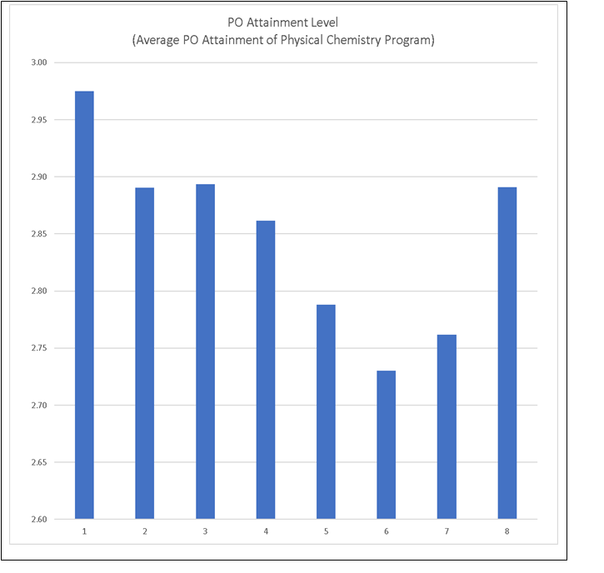
X-Axis = PO number
Y-Axis = PO Attainment value

Slide 19
ACTION TAKEN
Ability to conduct experiments
PO6 has an attainment of 2.73, which is less compared to others, project work has been implemented in the next year syllabus
Critical thinking and analytical skills
PO5 has an attainment of 2.79, which is less compared to others, MOOCS has been implemented in the next year syllabus
Ability to perform accurate quantitative measurements
PO7 has an attainment of 2.76, which is less compared to others, MOOCS has been implemented in the next year syllabus

Slide 20
BATCH : 2021-2023

Slide 21
ACTION TAKEN
Ability to conduct experiments
PO6 has an attainment of 2.89, which is increased than the previous year due to the implementation of project work in the syllabus
Critical thinking and analytical skills
PO5 has an attainment of 2.79, same as the previous year due to the implementation of MOOCS in the syllabus
Ability to perform accurate quantitative measurements
PO7 has an attainment of 2.87, increased than the previous year due to the implementation of MOOCS in the syllabus

Slide 22
CATEGORISATION OF STUDENTS FOR SLOW LEARNERS AND ADVANCED LEARNERS
YEAR | 2017
 | SL | AL
Dept. of Inorganic & Analytical Chemistry | 16 | 9
Dept. of PNCO | 13 | 4
Dept. Organic Chemistry | 9 | 11
YEAR | 2020
 | SL | AL
Dept. of Inorganic & Analytical Chemistry | 3 | 11
Dept. of PNCO | 5 | 2
Dept. Organic Chemistry | 5 | 2
YEAR | 2018
 | SL | AL
Dept. of Inorganic & Analytical Chemistry | 10 | 19
Dept. of PNCO | 9 | 13
Dept. Organic Chemistry | 4 | 10
YEAR | 2021
 | SL | AL
Dept. of Inorganic & Analytical Chemistry | 2 | 15
Dept. of PNCO | 3 | 1
Dept. Organic Chemistry | 5 | 2
YEAR | 2019
 | SL | AL
Dept. of Inorganic & Analytical Chemistry | 15 | 19
Dept. of PNCO | 4 | 11
Dept. Organic Chemistry | 4 | 14
YEAR | 2022
 | SL | AL
Dept. of Inorganic & Analytical Chemistry | 4 | 3
Dept. of PNCO | 1 | 1
Dept. Organic Chemistry | 3 | 2

Slide 23
Programmes for Advanced Learners
Encourage to present papers in Journals/ Conferences/ Competitions
Guidance for GATE/ CSIR NET competitive Examination
Individual guidance for summer research/career building apart from placements in the campus

Slide 24
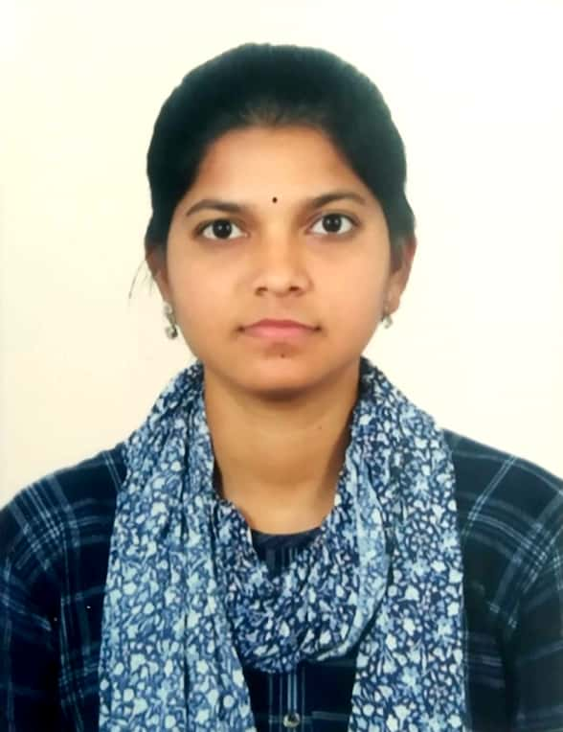
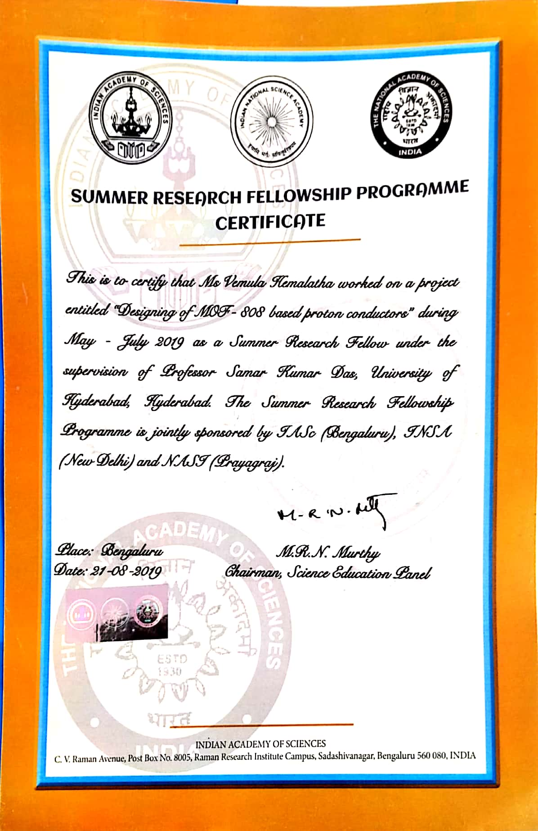
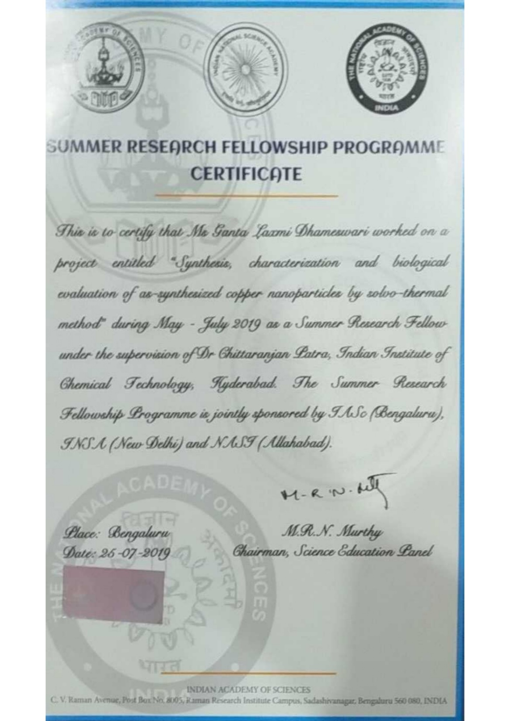
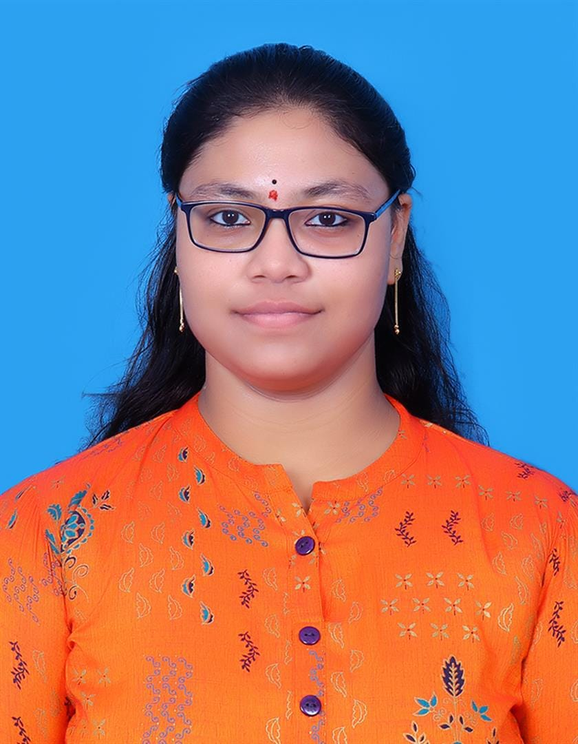
Y.HEMA LATHA
G.LAXMI DHAMESWARI

Slide 25
Improved Performance for slow learners
Assignments/ previous years question/midexam papers
Fortnightly Remedial classes
Individual Counseling

Slide 26
MENTOR-MENTEE REPORTS
120 students on an average
10 teachers on an average
Each teacher is allotted around 15 students
Mentoring is done once in fifteen days

Slide 27
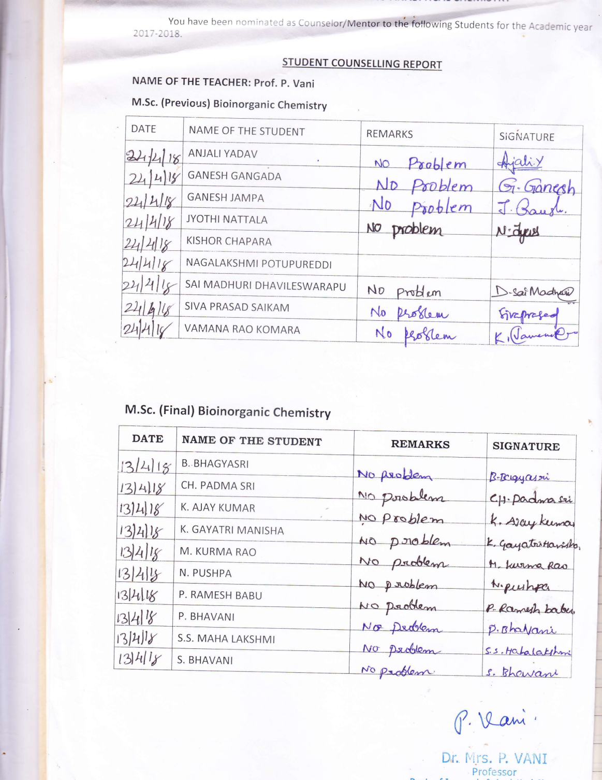
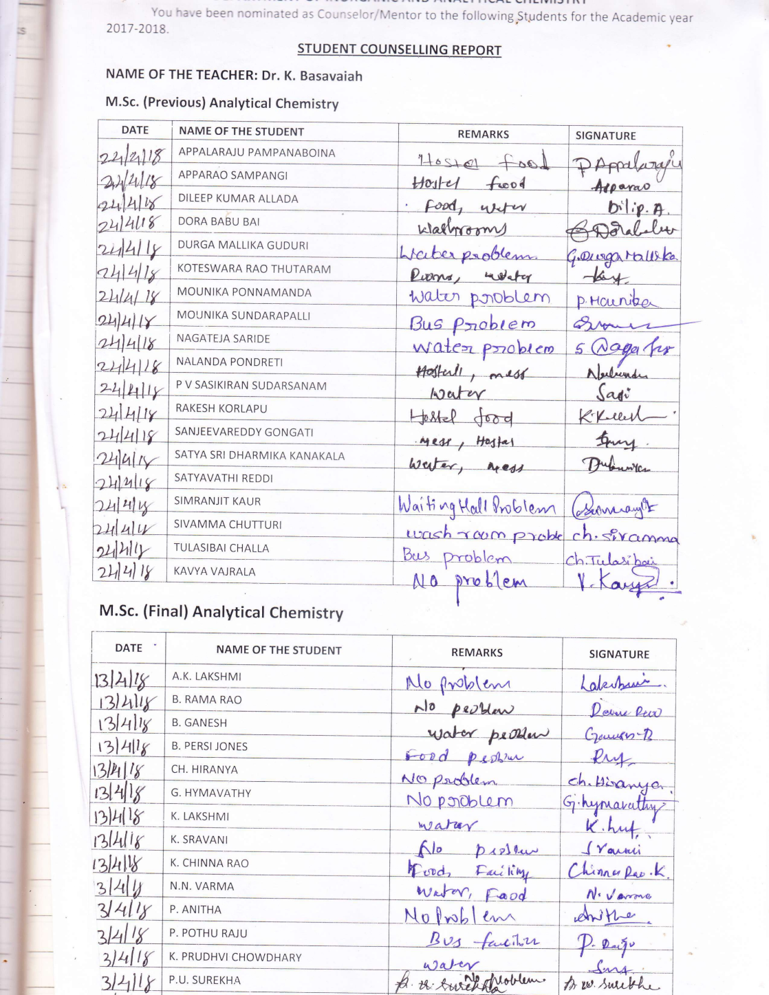

Slide 28
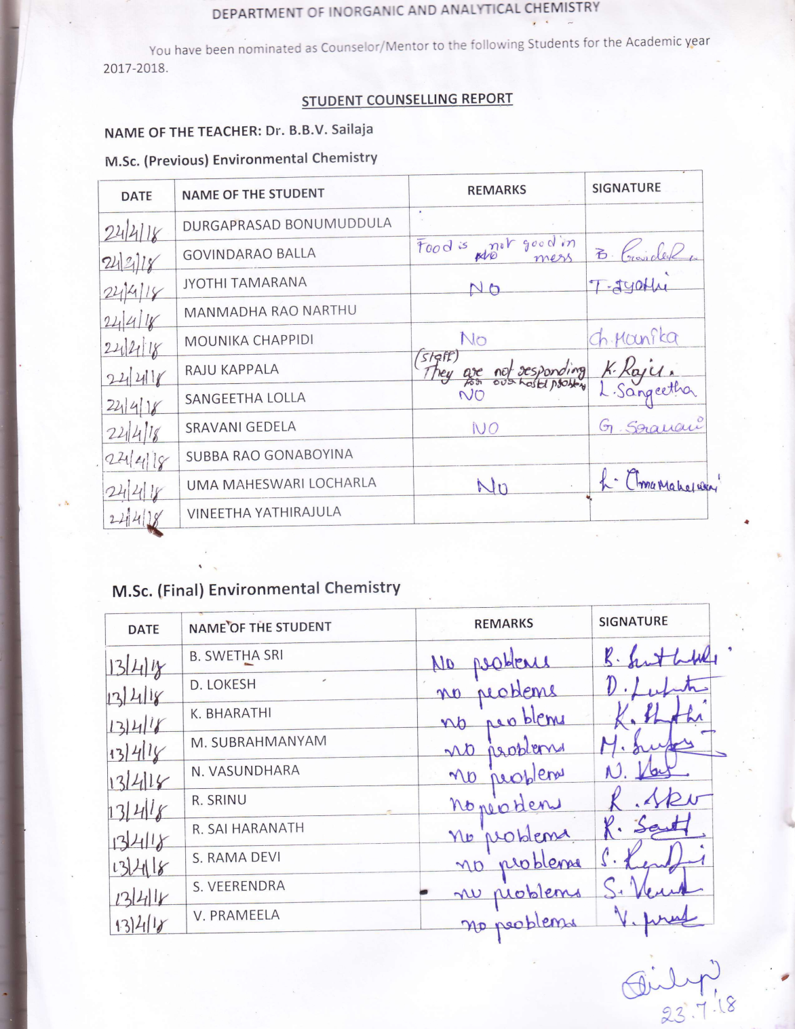
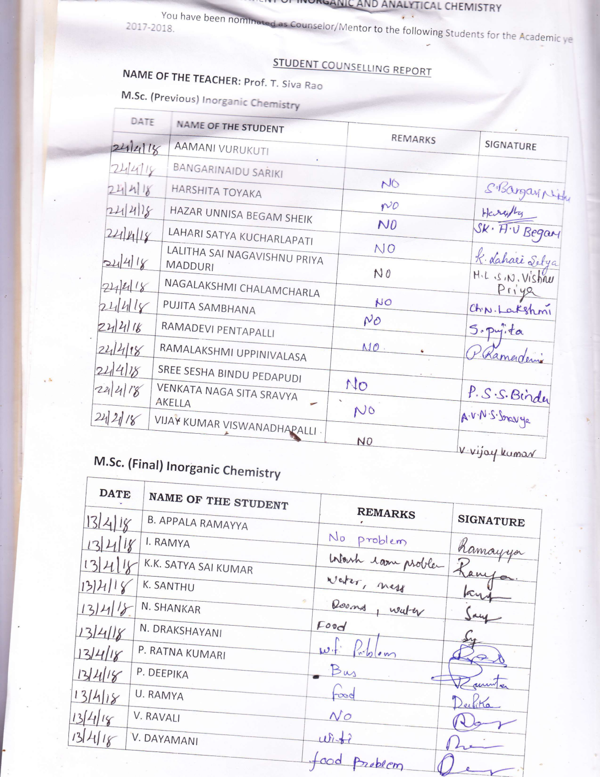

Slide 29
EVALUATION PROCESS
Semester-wise examination
Assignments
Two Mid examinations
Continuous assessment for laboratory and theory courses
External valuation of semester end examination
Comprehensive Grading is adopted

Slide 30
Results analysis/Pass Percentage
M.Sc. (FINAL) CHEMISTRY
YEAR | Total Admitted Students | Discontinued Students Count | Total Students attended for Exams | Passed | Failed | Pass %
2017 | 116 | 6 | 110 | 104 | 6 | 94.55
2018 | 117 | 7 | 110 | 103 | 6 | 93.64
2019 | 120 | 9 | 111 | 108 | 3 | 97.30
2020 | 126 | 5 | 121 | 115 | 5 | 95.04
2021 | 125 | 8 | 117 | 114 | 1 | 97.44
2022 | 127 | 2 | 125 | 122 | 3 | 97.60

Slide 31
FACULTY AND THEIR SPECIALISATIONS
S.No | Name of the Faculty member | Age Yrs | Highest qualification | H -index
1 | Prof. T. Siva Rao | 57 | M.Sc., Ph.D. | 24
2 | Prof. K. Basavaiah | 46 | M.Sc., Ph.D. | 35
3 | Prof. P. Shyamala | 53 | M.Sc., Ph.D. | 08
4 | Prof. V. Siddaiah | 45 | M.Sc., Ph.D. | 18
5 | Prof. B.B.V. Sailaja | 51 | M.Sc., Ph.D. | 17
6 | Prof. G. Venkateswara Rao | 58 | M.Sc., Ph.D. | 6
7 | Prof. K. Jaya Prasanthi | 47 | M.Sc., Ph.D. | 7
8 | Dr. P. Srinivasa Rao , Associate Professor | 49 | M.Sc., Ph.D. | 7
9. | Dr. P. Kamala, Associate Professor | 49 | M.Sc., Ph.D. | 6
10. | Dr. A. Chandra Leela , Associate Professor | 55 | M.Sc., Ph.D. | 6

Slide 32
FACULTY AND THEIR SPECIALISATIONS
S.No | Name of the Faculty member | Age Yrs | Highest qualification | H-index
11. | Dr. V. Christopher, Asst. Professor contract | 47 | M.Sc., Ph.D. | 8
12. | Dr. B. V. Srinivas, Asst. Professor contract | 46 | M.Sc., Ph.D. | 6
13. | Dr. D. Samsonu, Asst. Professor contract | 45 | M.Sc., Ph.D. | 3
14. | Dr. K.V.V. Satyanarayana, Asst. Professor contract | 47 | M.Sc., Ph.D. | 7
15. | Prof. G. Nageswara Rao, Emeritus Professor | 67 | M.Sc., Ph.D. | 23

Slide 33
Research Accomplishments /
Major Research Areas/ Themes
Major research areas | No of papers published(262)
Analytical chemistry | 125
Material Chemistry | 44
Physical Chemistry | 31
Organic Chemistry | 52
Environmental Chemistry | 10

Slide 34
Ongoing research projects
Total value : Rs. 3.2 Crores
Name of P I | Title of project and duration in Years | Project No. / Date of start | Amount sanctioned (Rs. Lakhs) | Funding Agency
Prof.K.Basavaiah | Development of carbon dot based functional materials for catalysis, Bio-imaging and anti counterfeit applications | SERB/F/10336/2021-22 | 30,08,764.00 | DST-SERB
Prof.V.Siddaiah | Design & development of new strategies for functionalization of remote Csp3 –H bonds via iminyl radical –triggered 1,5-hydrogen atom transfer (hat) cascade annulation reactions | DSTEEQ/2021/000168 | 37,78,764.00 | DST-SERB
Prof.B.B.V.Sailaja | Improved atmospheric correction procedures using NRT parameters | EOS-6/OCEANSAT-3 | 30,00,000.00 | ISRO-SERB
Prof.B.B.V.Sailaja | Air sea fluxes of Carbon dioxide from coastal Bay of Bengal influence of physical and bio chemical processes | NRSCBOB/ECSA/AOSG/OSO/NCP-CCO | 1,80,68,000.00 | NRSC-BOB
Prof. P. Shyamala | Synthesis and characterization of Nitrogen doped reduced graphene oxide (N-rGO) for hybrid capacitor. | NSTL/CARS/BUILDUP/2021-22/02 | 9,94,750.00 | NSTL-DRDO
Prof. K. Basavaiah | Green synthesis of metal and metal oxide nanoparticles from medicinal plants for catalysis and biomedical applications | Seed money grant- Andhra University | 25,00,000.00 | A.U.

Slide 35
Completed research grants during the last five years : Rs. 2.7 crores
Name of P I | Title of project and duration in Yrs | Project No./ Date of start and closure | Amount sanctioned (Rs. Lakhs) | Funding Agency
Prof T.Siva Rao | Poly 3-Thionic acid-(TiO2- Cu) nanohybrids: Twin applications ineffective photocatalysis and polymer sensitized solar cells. | SERB/F/1767/2015-16 .(Dt : 06-07-2015) | 43,00,000.00 | DST-SER, New Delhi
Dr. K. Suresh Babu | Transformative Crystalline hybrid Porous Materials; Chemical Synthesis and Applications | A.V(2)/DST-INSPIRE 7-7-2021- CLOSED | 35,00,000.00 | DST-INSPIRE
Dr. K. Suresh Babu | Stabilization of Single Metal Atoms/Clusters over Redox Active Two Dimensional Conductive Crystalline Frameworks for Chemiresistive Hydrogen Gas Sensing | CRG/20191003925(DT:31-01-2020 TO 31-01-2023 | 49,00,000.00 | DST-SERB
Dr. K. Suresh Babu | Synchrotron X-ray Absorption Spectroscopy Analysis (EXAFS and XANES) of Single Metal Atom Confined Materials for Toxic Gas Sensing | CSR-ICISUM-48/CRS-33/2020-21/789 | 8,00,000.00 | UGC-DAE
Prof. P. Shyamala | Sea Water Quality monitoring(Coastal Research scheme) | MOES/ICMAM/PD/SUPPLEMENTARY ORDER/81/2017 DT 22-3-2018 to 22-3-2021 | 19,79,000.00 | MOES,NCCR
Prof. K. Basavaiah | Operation and maintainence of continuous online air-quality monitoring at three areas of visakhapatnam | 02-05-23 to 02-02-24 | 30,19,200.00 | VPT, Vizag
Prof. P. Shyamala & Prof. Y.L.N.Murthy | In-depth investigative studies on Novel synthetic process of C6 perfluoro ketone (novec 1230) for upscaling (optimization, recycling & economic viability) | (CARS )CONTRACT FOR ACQUISITION OF RESEARCH SERVICES 31/12/2018 to 05-2022 | 1,14,87,000.00 | CFEES, DRDO

Slide 36
S. No. | FUTURE MAJOR RESEARCH AREAS PLANNED
1. | Marine Chemistry (Marine natural products and marine-pollutions )
2. | Material Chemistry(Design and synthesis of multifunctional metal/non metal/ bimetallic nanomaterials and their applications)
3. | Organic Chemistry(Development of new synthetic methodologies for heterocyclic molecules)
4. | Computational chemistry (Structure optimization , DFT)

Slide 37
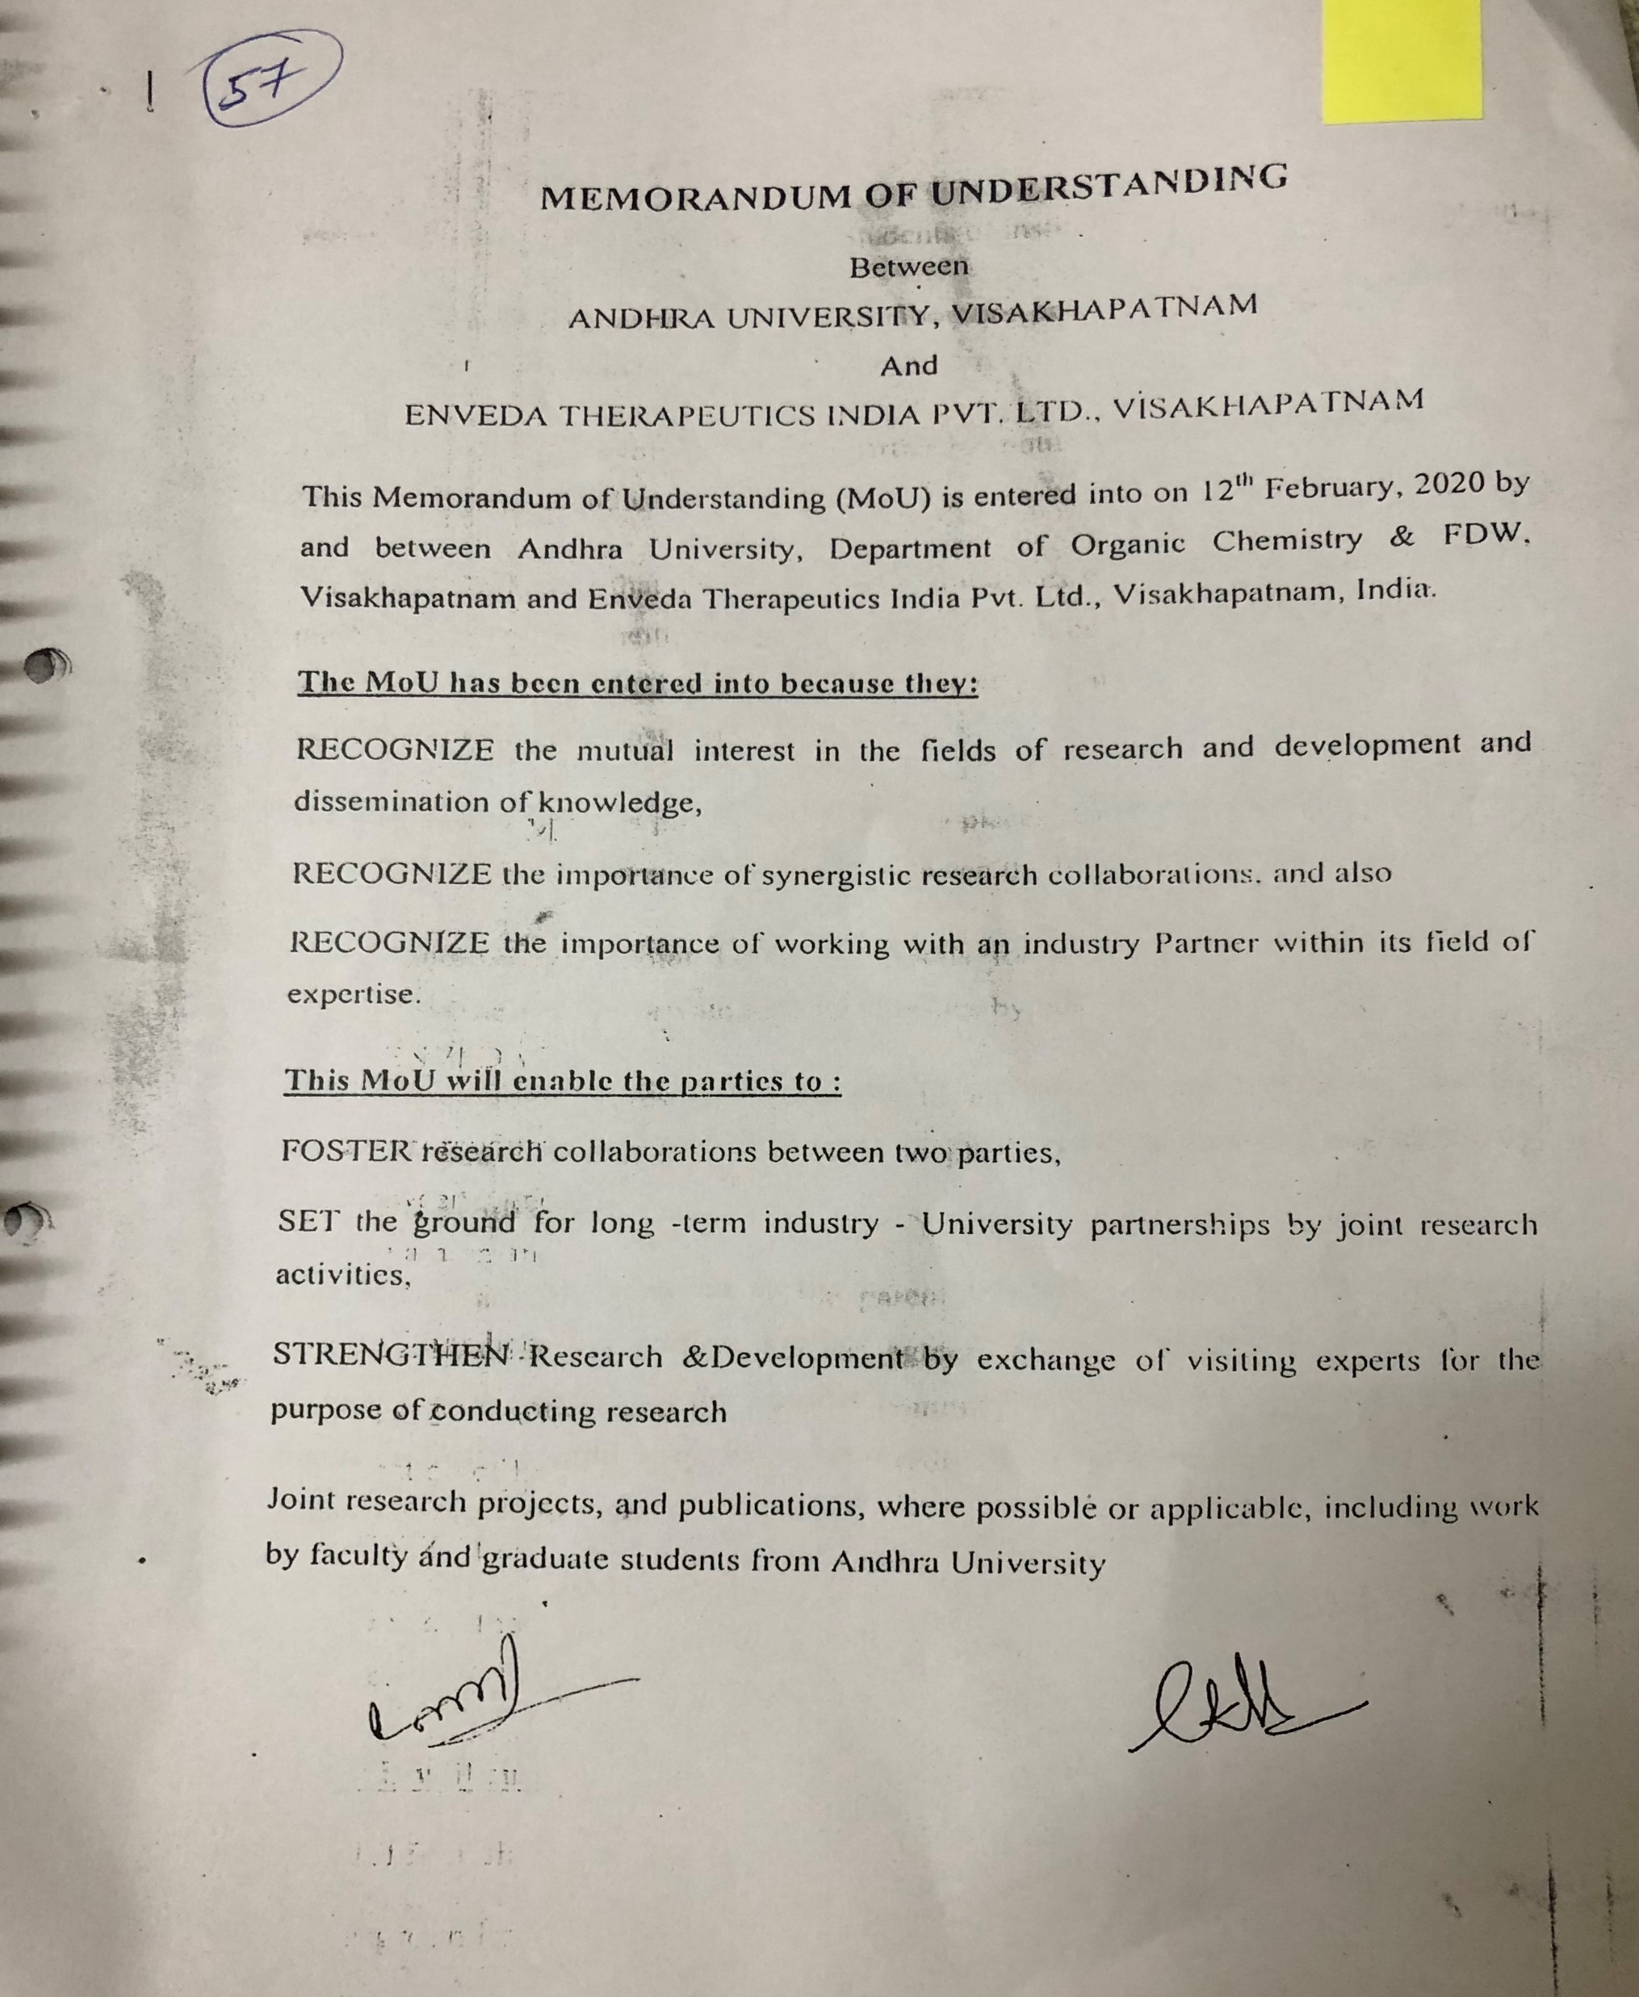
Dr. G.V. Subbaraju
Enveda
VP Synthetic and NP Chemistry

Slide 38
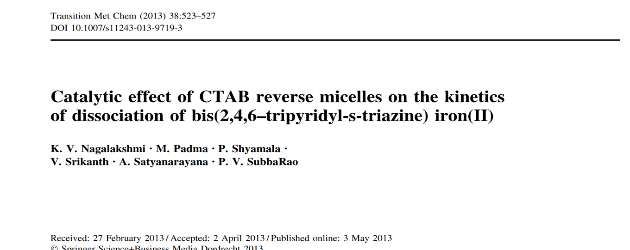
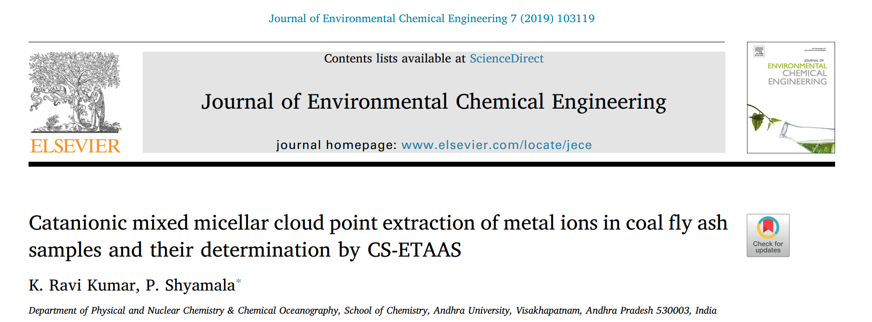
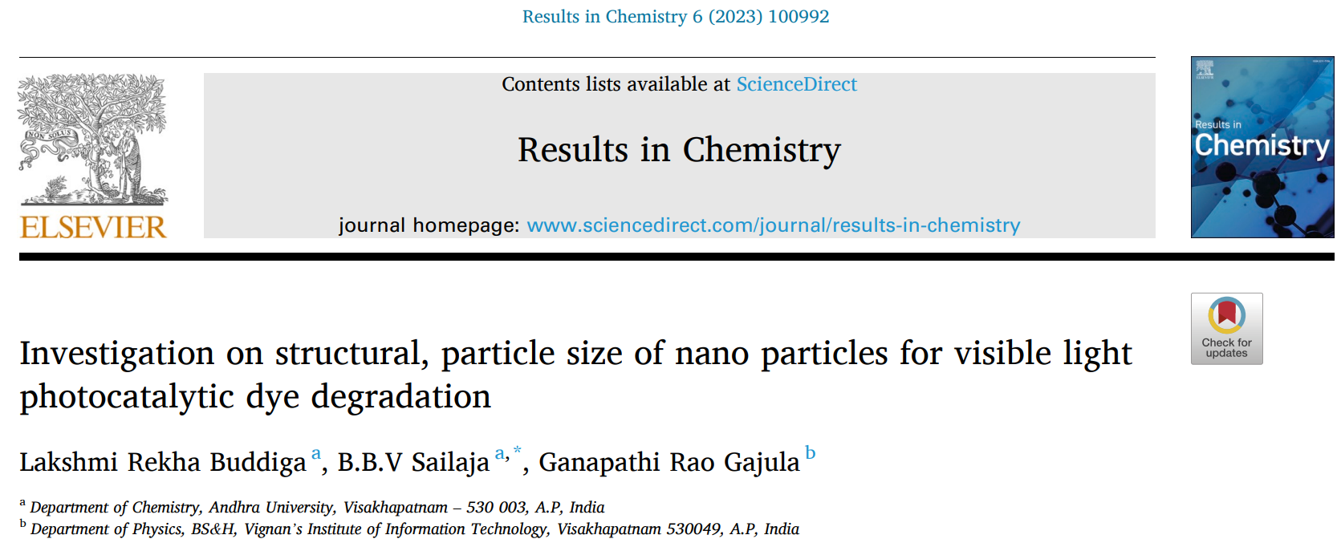
SOME GOOD PUBLICATIONS

Slide 39
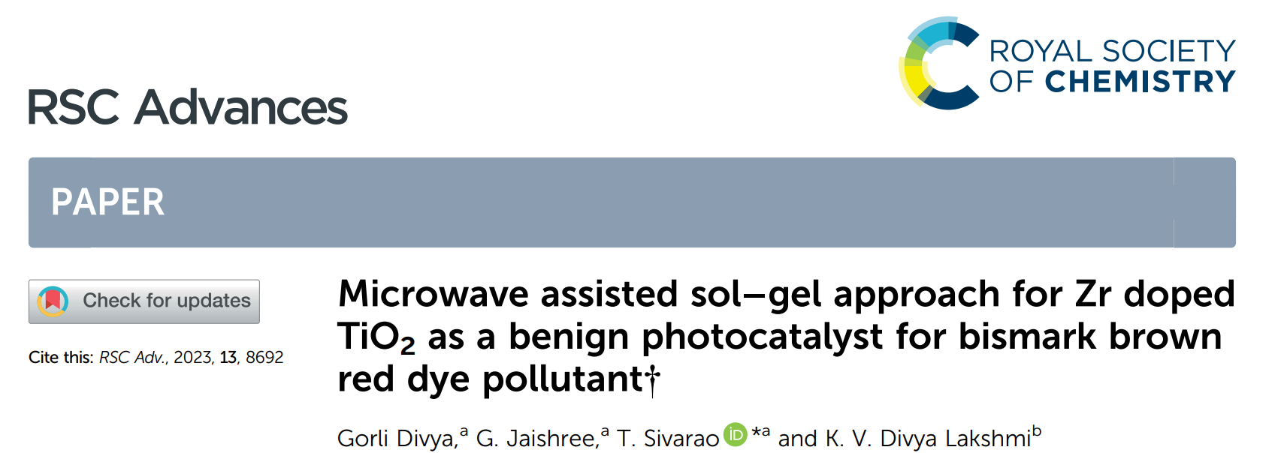
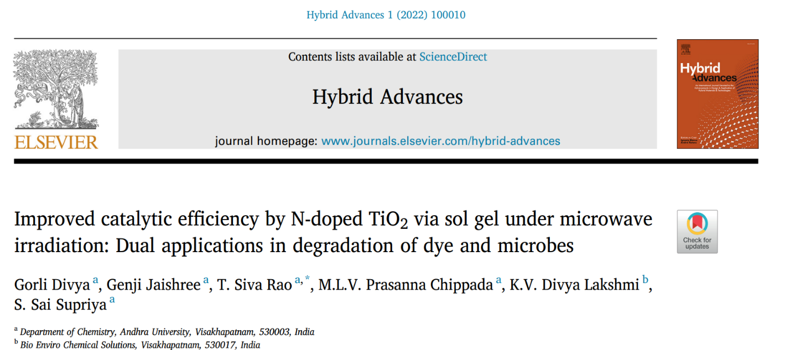
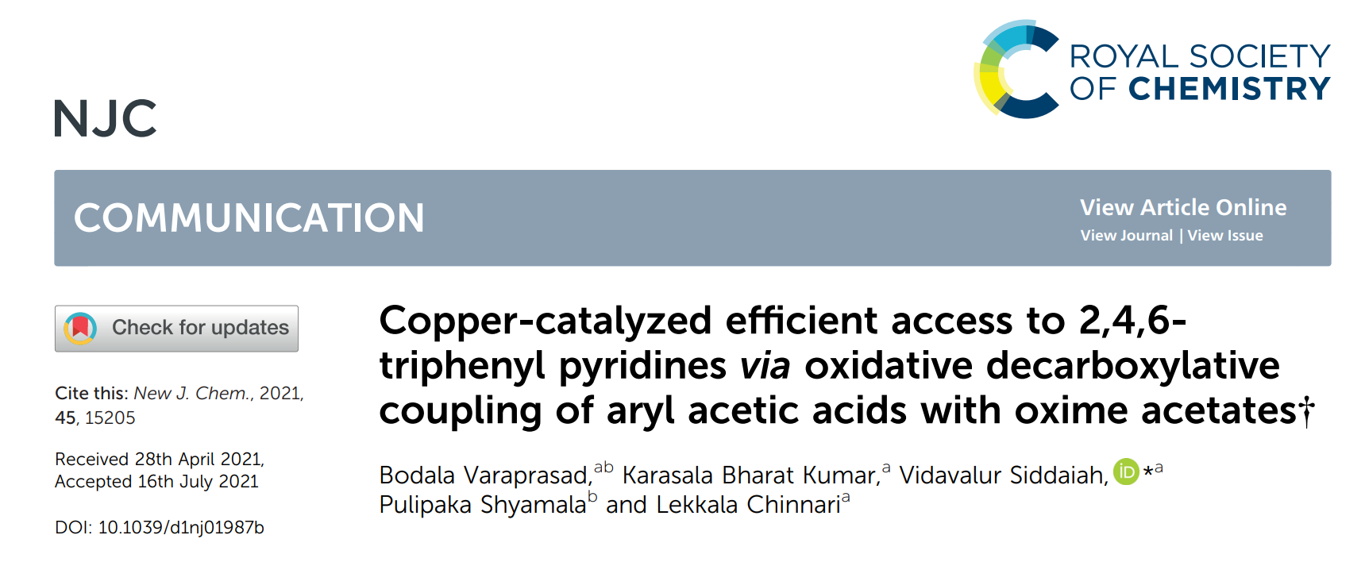

Slide 40
PATENT | PUBLICATION DATE
Metal free Hydrogen sensors and method of fabrication Thereof, Indian Patent, application number -202241032960A, | 17-06-2021
Colpomenia sinuosa based biosynthesised nanoparticle compositions for antitumor activities, Indian Patent, application number -202141041800A . | 01-10-2021
Dioscorea villosa extract based herbal composition for wound healing and its preparation methods thereof Indian Patent, application number -202141034471 | 6-08-2021
Halymenia porphyroides based biosynthesized nanoparticles composition for diabeties activity. India Patent number -202141048604, pages no 314. | 05-11-2021
Composition for reducing risk of cardiovascular diseases South African patent (patent filed)
Adoptable tillage systems for tractors and method of operation,Indianpatent(utility grant patent) application number 202241032937A | 17-06-2022
Phyllanthus niruri as a promising alternative treatment for Jaundice. Indian paten. Patent number -20214125042A, page no 303 | 05-06-2021
Title of the invention: Metal-Free Hydrogen Sensor and Method of Fabrication Thereof, Application No.202241032960 A PATENT APPLICATION PUBLICATION INDIA | 17/06/2022

Slide 41
Faculty in Administrative Positions
Name | Position hold
Prof. A. V. Prasada Rao | Former Vice Chancellor, Rayalaseema University Former In-charge Vice Chancellor, Adikavi Nannaya University
Prof. G.Nageswara rao. | Former Vice Chancellor, Andhra University 2016-19. NAAC Peer Team Chairman since, 2019 Mentor,Central Tribal University,Vizianagaram.
Prof. M. S. Prasada Rao | Former Registrar, AU Former Vice Chancellor, GITAM University
Prof. K.Basavaiah | Dean, R&D, Andhra University(2021-present) Chairman, Board of Studies, Department of Chemistry
Prof. P. Shyamala | Head, Department of Chemistry(2022-present)
Prof. V. Siddaiah | Associate Dean, College Development council, Andhra University (2019-present)

Slide 42
Infrastructure and Learning Resources
Physical Facilities | Lecture rooms- 10 , Laboratories - 08
Library | 01(2000 volumes)
I.T. Infrastructure | LCD projectors -06
Computer room | 01
Seminar halls | 01
Research labs | 05
Smart Boards | 03

Slide 43
AQUEOUS
DILUTE AND DISPERSE
Washed down the drain after dilution/neutralisation.
ORGANIC SOLVENTS
RECYCLE AND REUSE
Recycled after distillation.
Solid waste/Broken glass ware
CONCENTRATE AND CONTAIN
Pits are dug for unlabeled/ contaminated chemicals
Private agencies after few cycles.
Glass ware in plastic boxes.
PRINCIPLES OF CHEMICAL WASTE MANAGEMENT

Slide 44
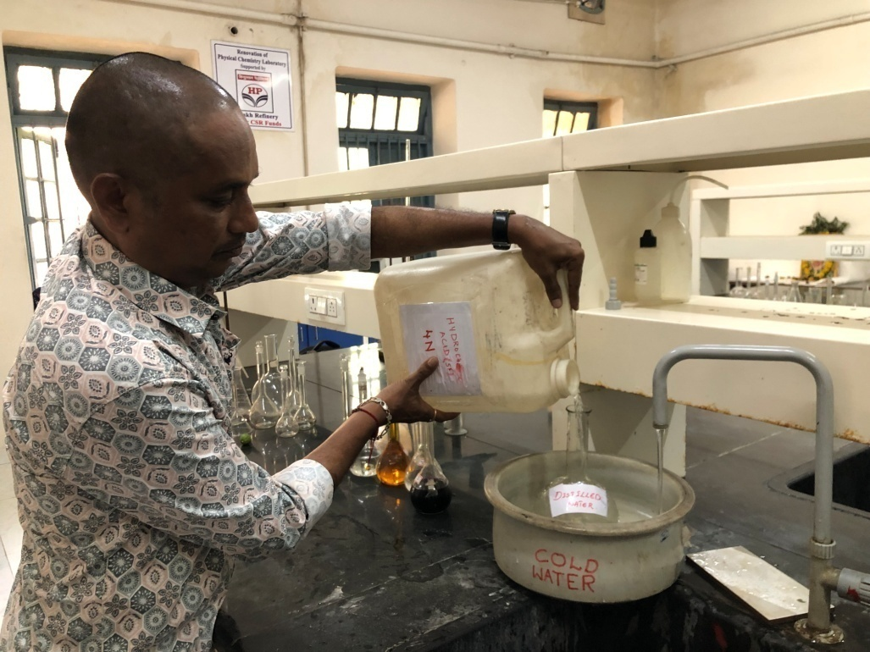
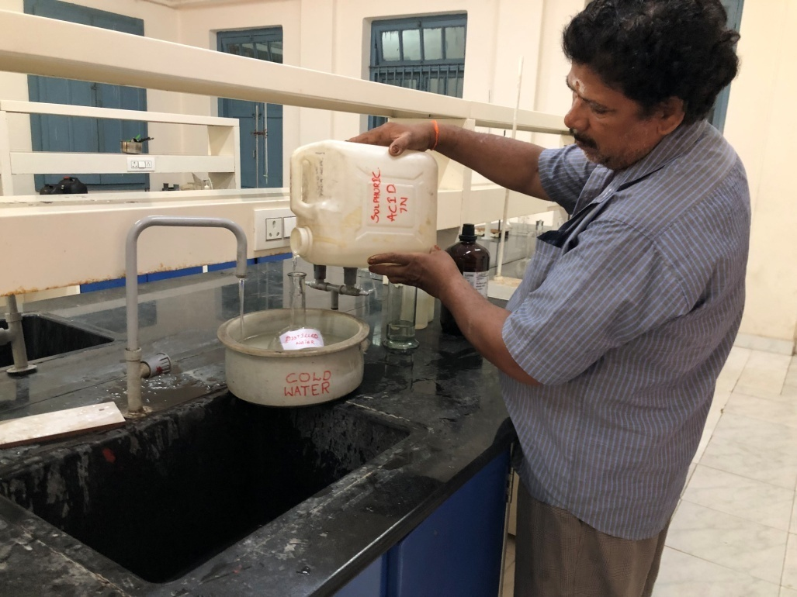
DILUTE AND DISPERSE
STRONG ACIDS/ BASES ARE EITHER NEUTRALISED OR DILUTED WITH EXCESS WATER
THEN DISPOSED THROUGH SEWAGE/DRAINS

Slide 45
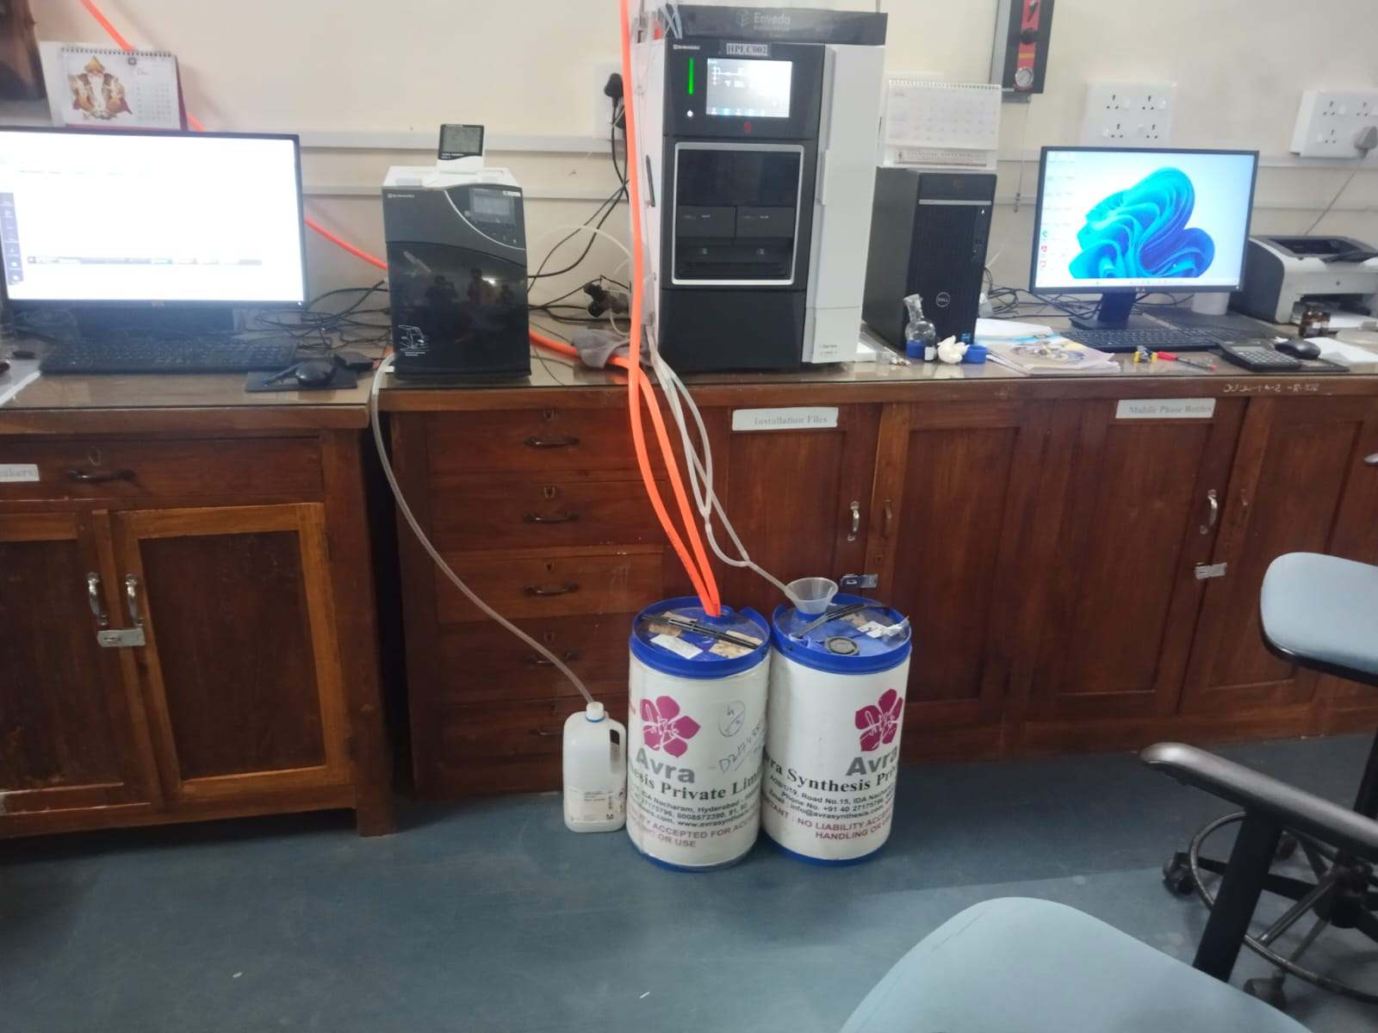
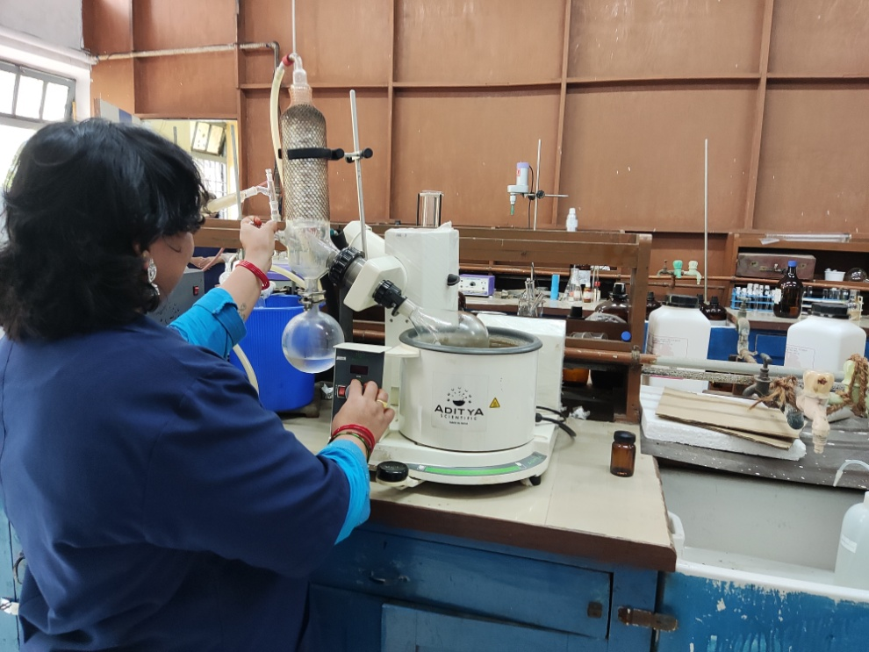
RECYCLE AND REUSE OF ORGANIC SOLVENTS FROM REACTION VESSELS

Slide 46
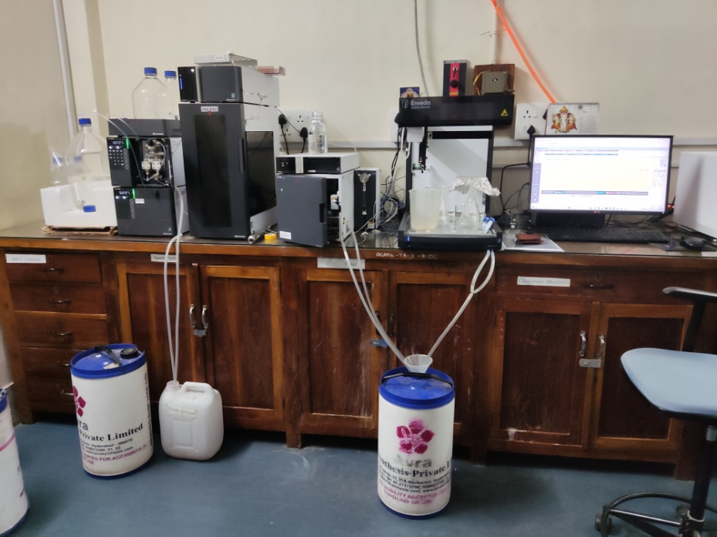
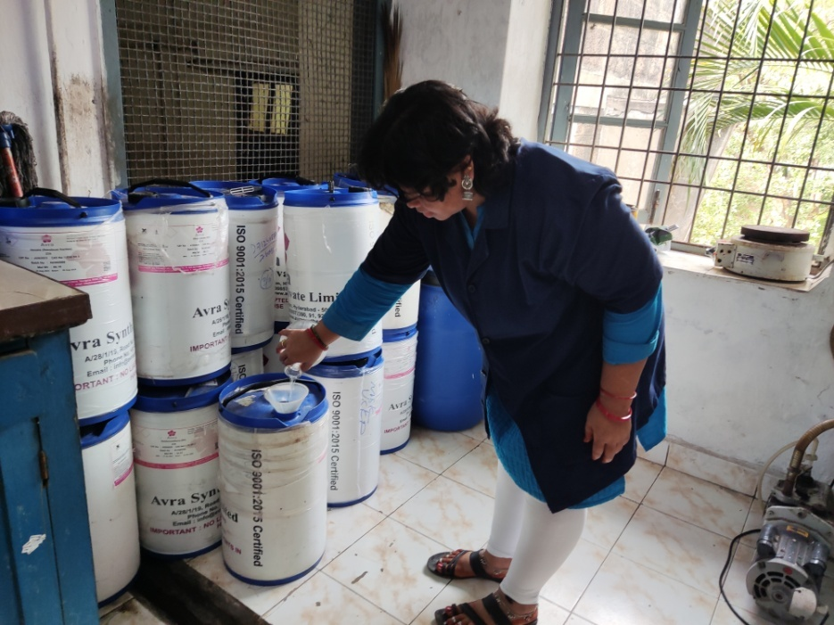
RECYCLE AND REUSE OF ORGANIC SOLVENTS FROM HPLC

Slide 47
CONCENTRATE AND CONTAIN
Solid wastes ( unlabelled , untagged chemicals,
used gloves, contaminated vails/bottles)
Laboratory attenders at work: STORAGE OF REFUSE IN PITS

Slide 48
Equipment in the DST-FIST/UGC-SAP
S. No. | Name of the equipment
1 | BET surface area analyzer
2 | Spectro Fluorimeter
3 | HPLC
4 | Millipore water purifier
5 | FTIR spectrometer
6 | Auto-Titrator
7 | Ultrasonicator
8 | Stopped flow Spectrophotometer
9 | Rotatory evaporator

Slide 49
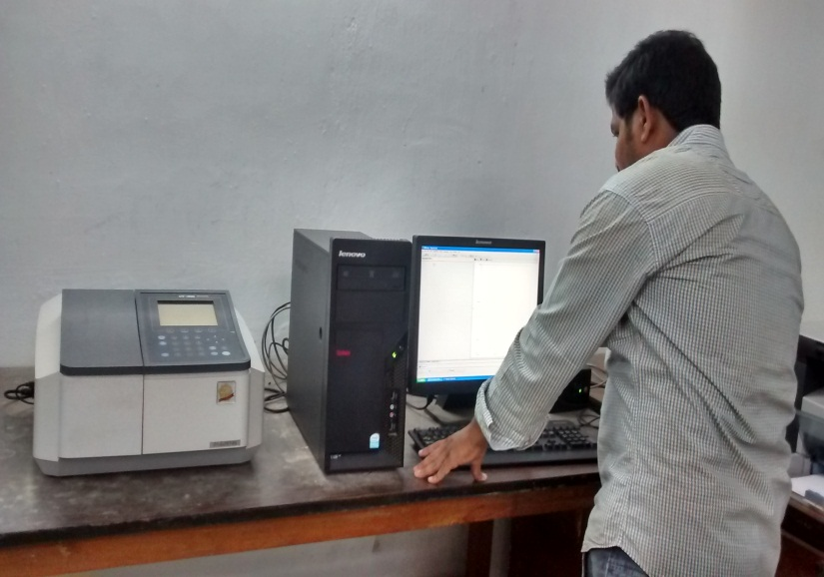
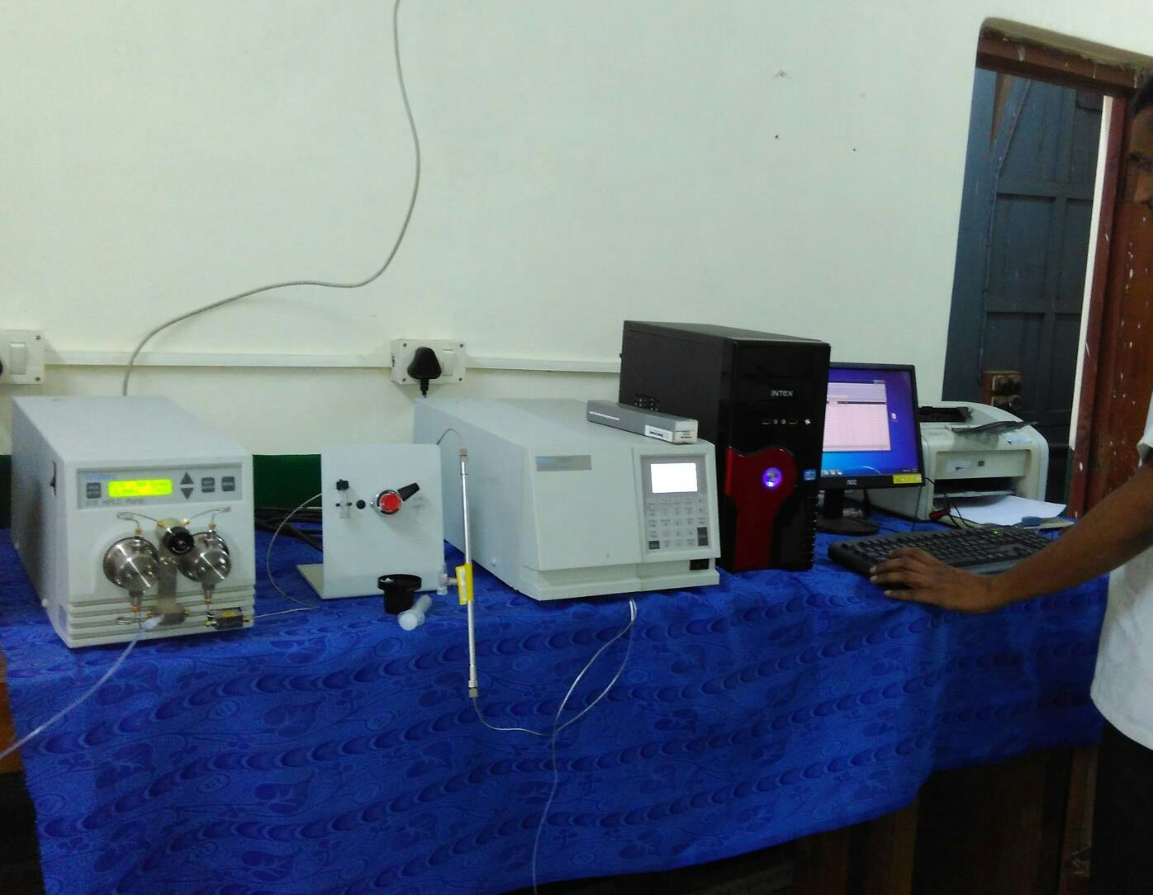
UV-Visible Spectrophotometer
High Performance Liquid Chromatography (HPLC)

Slide 54
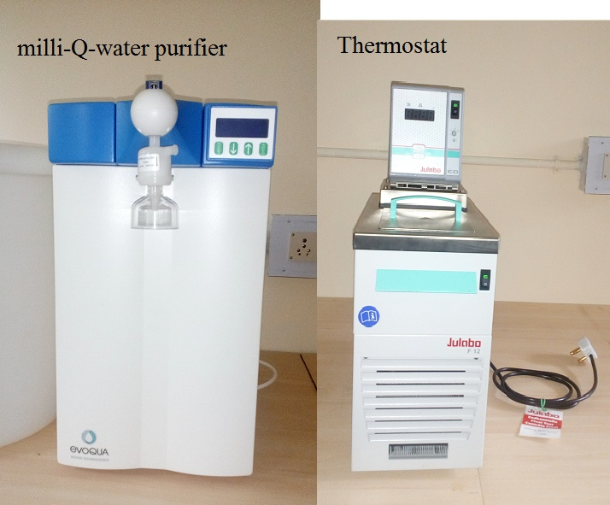

Slide 55
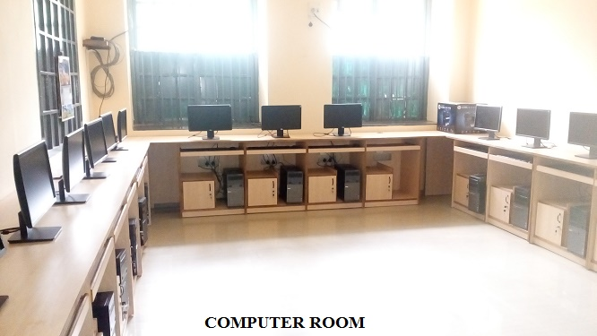
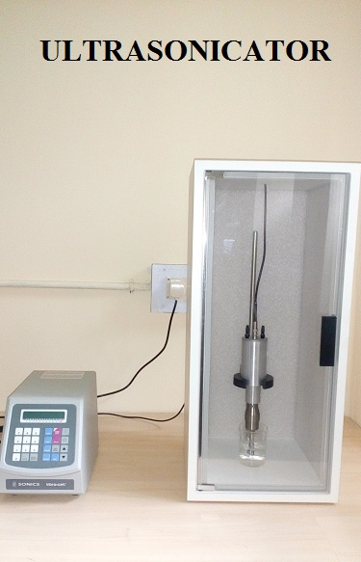
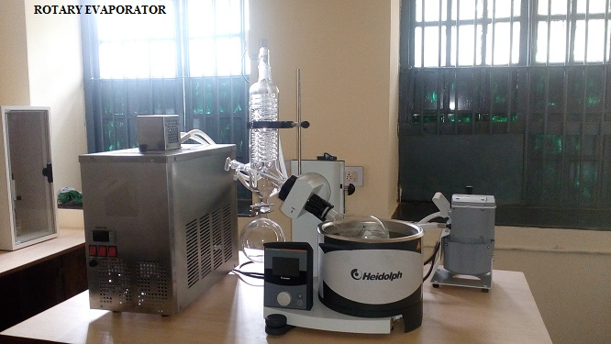

Slide 56
Awards to students
The following prizes will be given to the meritorious students at the time of convocation by our alumni 1. Prof. T.R. Seshadri Sashtiabdapoorti Prize
2. Prof. Bh.S.V. Raghava Rao Memorial Prize
3. Sir R. Subbaiah Memorial Prize
4. Prof. G. Gopala Rao Sastiabdapoorti Prize
5. Late Smt. Lakkaraju Sarojinidevi Prize
6. Prof. S.R. Sagi Sastiabdapoorti Prize
7. Prof. U. Muralikrishna Sastiabdipoorti Prize
8. Maharaja Dr. Vikram Deo Varma Medal
9. Sri Kenjerla Venkateswarlu Memorial Prize
10. Prof. A.V. Prasada Rao Sastiabdipoorti Prize
11. Prof. M.N. Sastri Sashtiabdapoorti Prize
12. Prof. P.V. Subba Rao Sashtiabdapoorti Prize
13. Prof L R Row Best Thesis Award
14.Prof A.Uma Bala award
15.Prof.P.V.Krishna Rao award
16.Prof.Deekshitulu award

Slide 57
Infrastructures and teaching resources
Department library having around 2000 books
Log books maintained for issue of books
Centralised e-resources available

Slide 60
Institution values and Social responsibilities
Green Campus- Swach Bharat every alternate Saturday.
Construction of girls toilets.

Slide 62
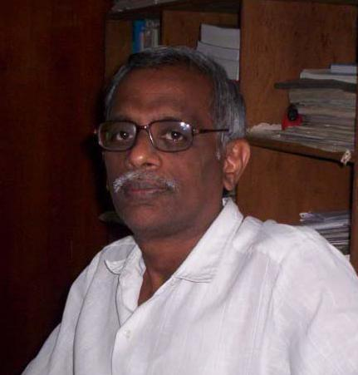
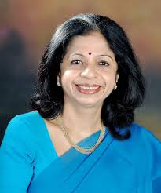
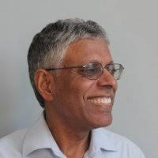
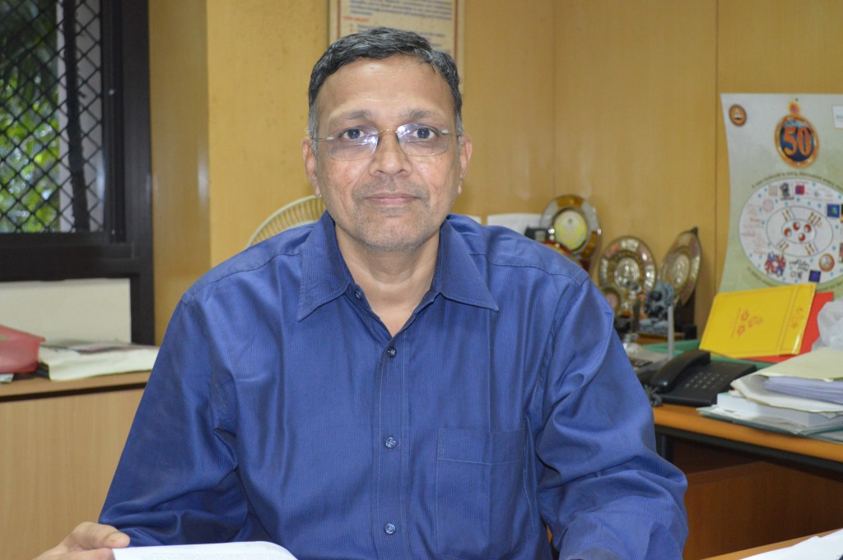
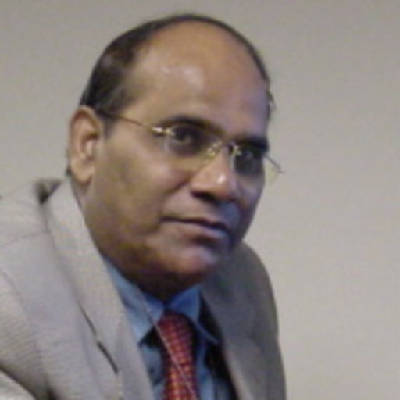
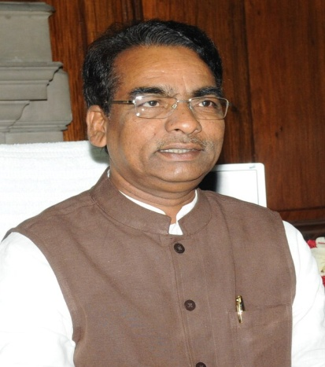
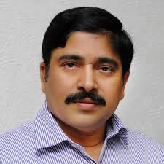
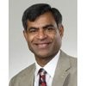
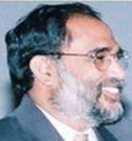
Prof. G.S.R. Subba Rao
Bhatnagar Awardee,IISc,Bangalore
Prof. A. Srikrishna
Bhatnagar awardee,
IISc,Bangalore
Dr. Vijayalakshmi Ravindranath
Padma Shree Awardee, Bhatnagar Awardee, Professor and Chairperson, Centre for Neuroscience, Indian Institute of Science, Bangalore
Dr. Murali Gavini, F.D.A. U.S.A.
Prof. U.Varada Raju
Head, Department of Chemistry, IIT, Chennai.
Prof. Desu Seshu B.
Head, Dept. of Electrical and Computer Engineering, Univ. of Massachusetts Amherst, MA, USA.
Dr. J.D. Seelam
I.A.S, Former Union Minister, Govt. of India , Member of Parliament, Rajya Sabha
Sri J. Murali, I.A.S.
Prof. Pedi Reddy
IIT, Bhubaneswar
Prof. Y. Anjaneyulu
Director, Trent Lott Geo Spatial and Visualization Centre, Jackson Univ., Jackson, MS

Slide 63
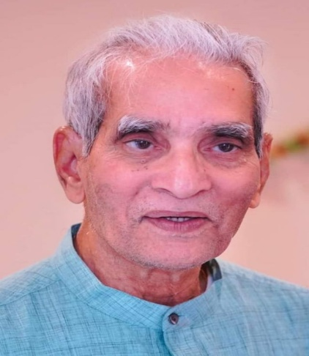
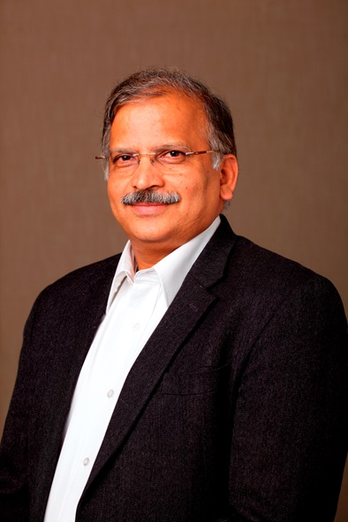
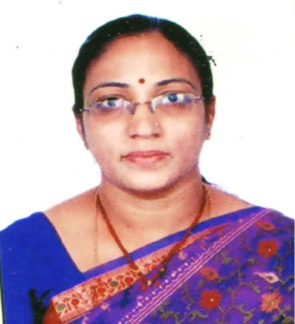
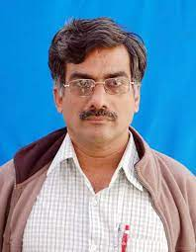
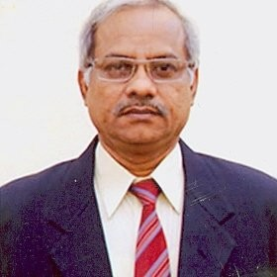
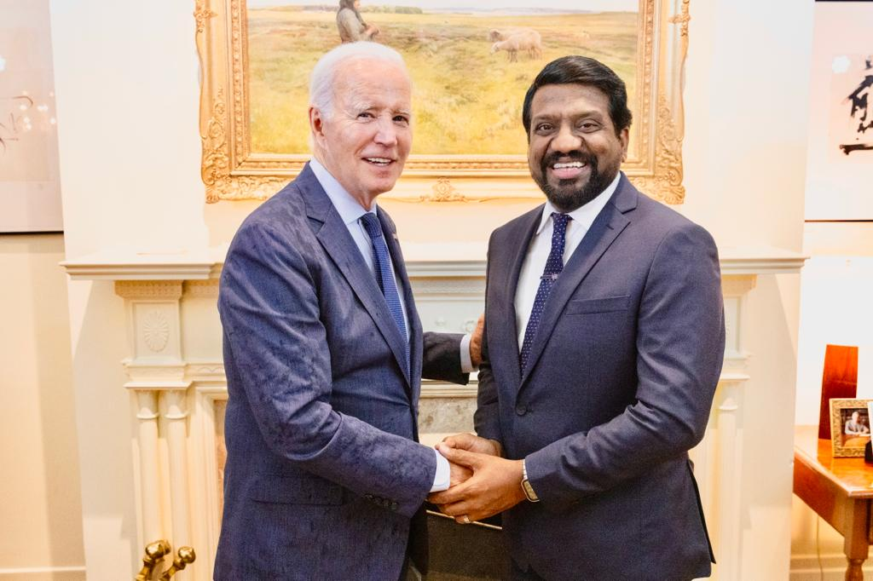
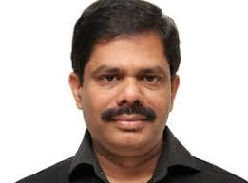
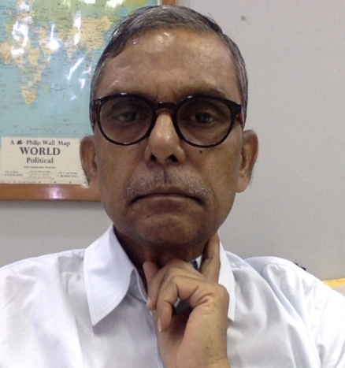
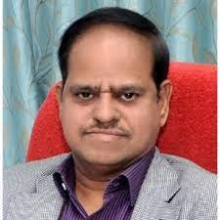
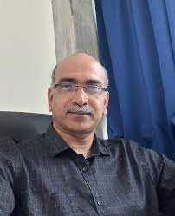
Dr. Yogeswara Rao .
Member, Scientific Advisory Committee to PM,
New Delhi
Prof. B. Rama Devi
Head, Department of Chemistry, JNTUH C&H, Hyderabad
Dr. T. S. R Prasada Rao
Director , Indian Institute of Petroleum, Dehradun
Dr.C.Satyanarayana
CEO, Laurus labs,
India
Prof. Anand K. Kondapi
School of Life Sciences
University of Hyderabad
Dr. Deva H Puranam
Global Head, Viatris
Dr. B.Hari babu
MYLAN
Dr.V. Lakshminarayana
Director, Technical, GR Intra Chem Limited, Hyderabad
Dr.P. Shiva Swaroop
IGNOU Regional Director,
New Delhi
Prof. Ch. Subrahmanyam
IIT, Hyderabad

Slide 64
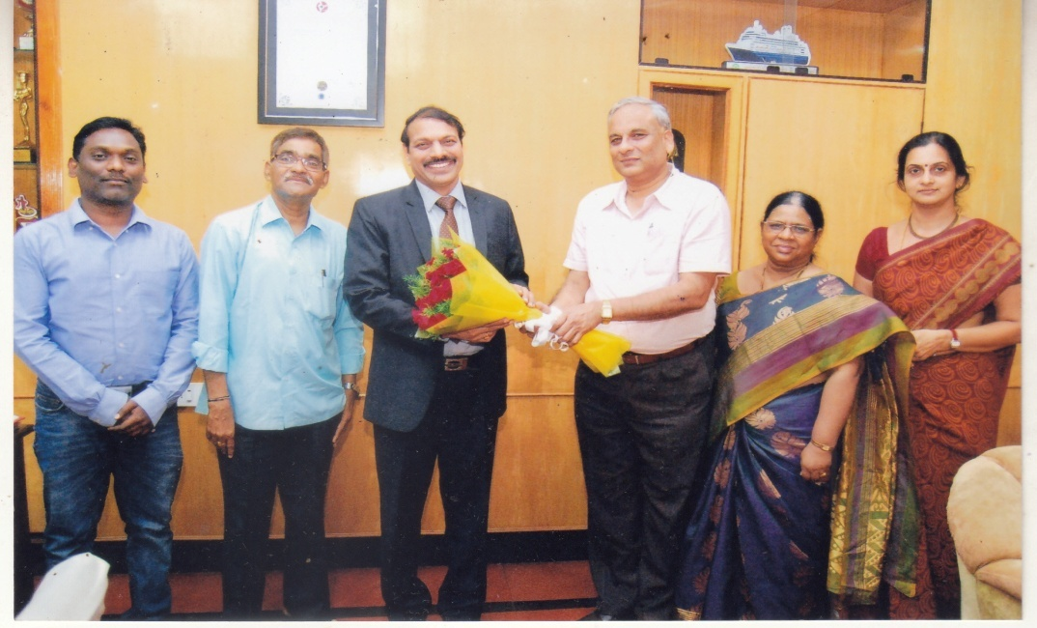
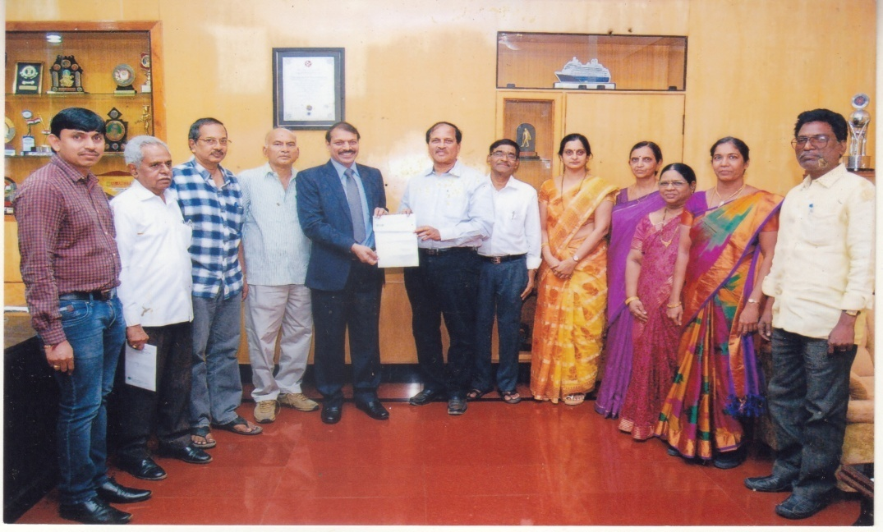
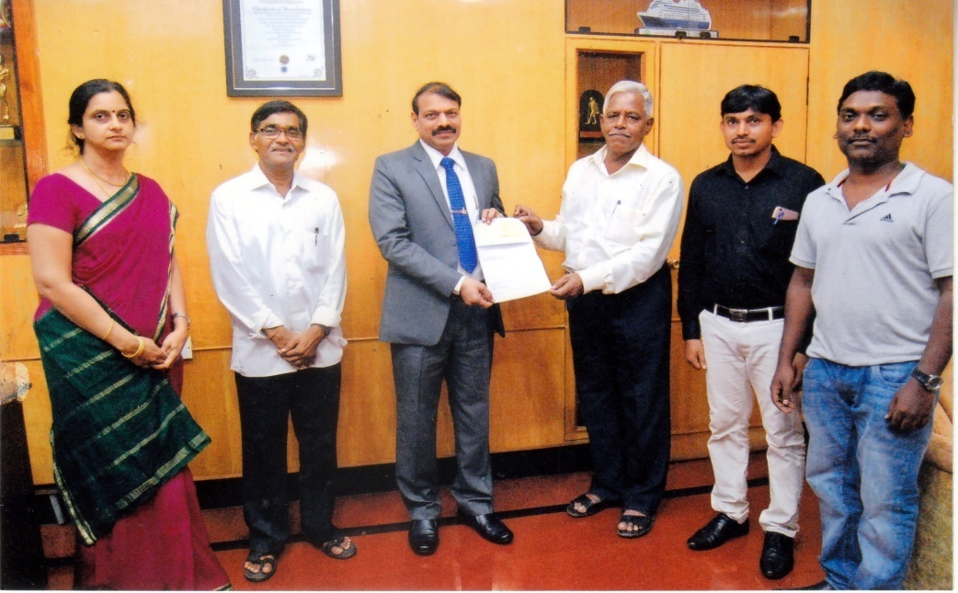

Slide 66
TOTAL NUMBER OF SEMINARS / CONFERENCES AND TRAINING PROGRAMS ATTENDED
SNO | NAME OF THE FACULTY | TOTAL NUMBER OF CONFERENCES/SEMINARS ATTENDED
1 | Prof. T. Siva Rao | 02
2 | Prof. P. Shyamala | 23
3 | Prof. K. Basavaiah | 06
4 | Prof. V. Siddaiah | 20
5 | Prof. B.B.V. Sailaja | 10
S No | NAME OF THE CONFERENCES /WEBINARS/SEMINARS | DATE
1 | Annual conference of Indian Council of Chemists(ICC) | 27th-29th ,December,2017
2 | Recent advances in Inorganic and Analytical chemistry | 30th ,July,2018
3 | National colloquium on “Applications in Nuclear Chemistry”(NUCHEM-2018) | 1st ,September,2018
4 | International Conference on Recent Advances in Chemical, Pharmaceutical and Life Processes(RACPL-2019) | 13th-15th,July,2019
5 | Two Day National Seminar on Chemical Speciation in Biology and Marine Environment (CSBME-2019) | 29th-30th ,September,2019
6 | A Two Day national Webinar (Faculty Development programme) on “Analytical and Diagnostic Tools in Chemical and Life Sciences” | 05th -06th June,2020
7 | Three Day International Virtual Conference on Impact of “ Chemical Disasters on Biota(ICDB-2020) | 24th-26th July,2020
8. | International year of periodic table | 28th september 2019

Slide 82
Future Plans
To develop industry relevant add-on courses
To Organize a MOOCS.
To organize NET classes
To organize an International Conference
To introduce diploma course in
Instrumental methods of analysis

Slide 83
THANK YOU

